Slide 1
Intro R markdown
MSc. Andres Mauricio Cifuentes Bernal.​
PhD candidate: Computer and Information Science (Bioinformatics)​
STEM – University of South Australia​

Slide 2


Reporting with R Markdown
https://rmarkdown.rstudio.com/
https://vimeo.com/178485416

Slide 3
Reporting with R Markdown
# Install from CRAN
install.packages('rmarkdown')
# Or if you want to test the development version,
# install from GitHub
if (!requireNamespace("devtools"))
install.packages('devtools')
devtools::install_github('rstudio/rmarkdown')
Useful resources:
The R Markdown Cheatsheet
The R Markdown Reference Guide

Slide 4
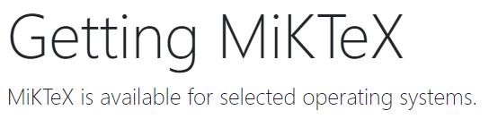
Reporting with R Markdown
If you want to generate PDF output, you will need to install LaTeX
For R Markdown users who have not installed LaTeX before, it is recommended to install TinyTeX (https://yihui.name/tinytex/):
install.packages('tinytex’)
tinytex::install_tinytex() # install TinyTeX
If you use LaTeX outside R markdown (e.g. writing papers).
https://miktex.org/download

Slide 5
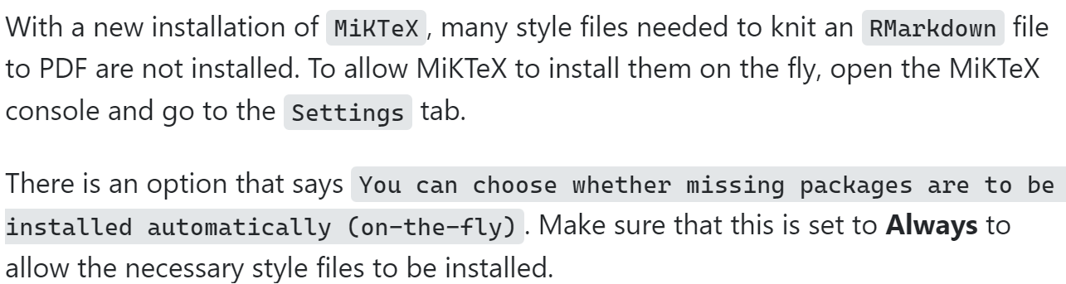
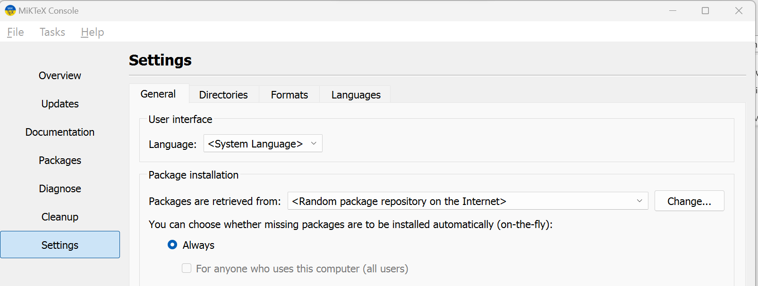
Common issues

Slide 6
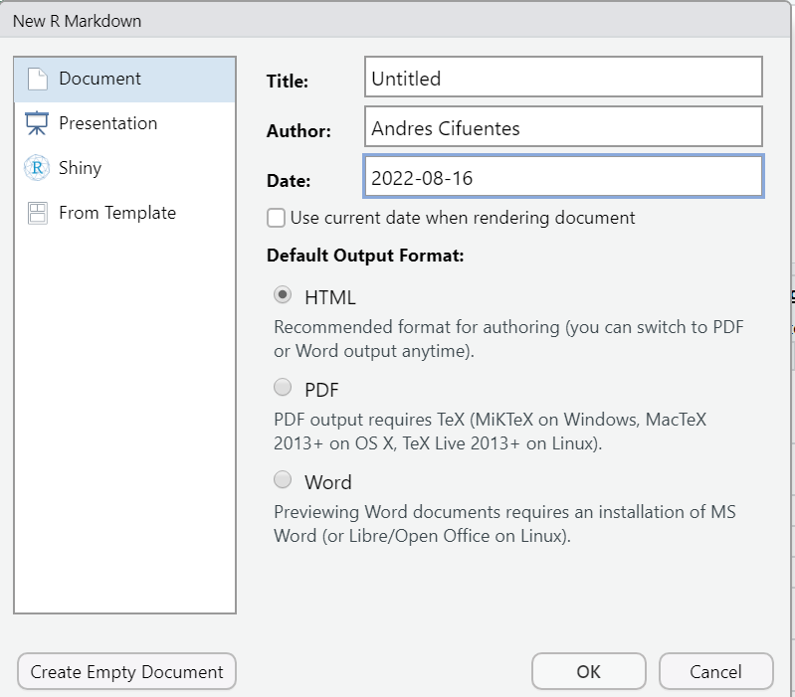
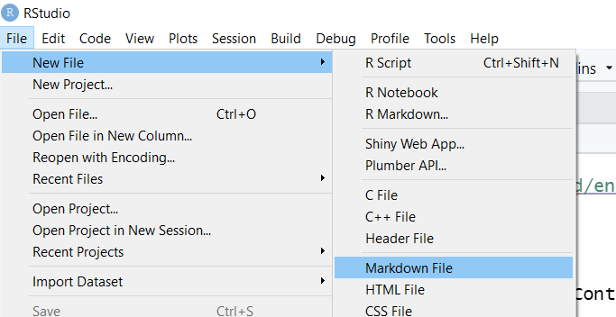
Reporting with R Markdown
An R Markdown file is a plain text file that has the extension .Rmd

Slide 7
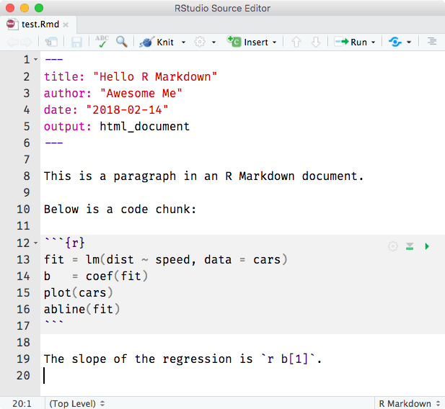
Reporting with R Markdown
Notice that the file contains three types of content:
An (optional) YAML header surrounded by ---
R code chunks surrounded by ```
text mixed with simple text formatting

Slide 8
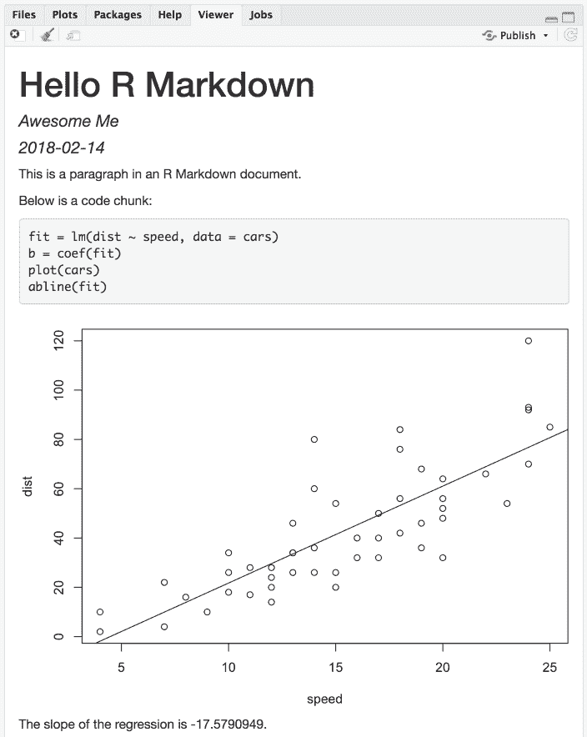
Reporting with R Markdown

Slide 9
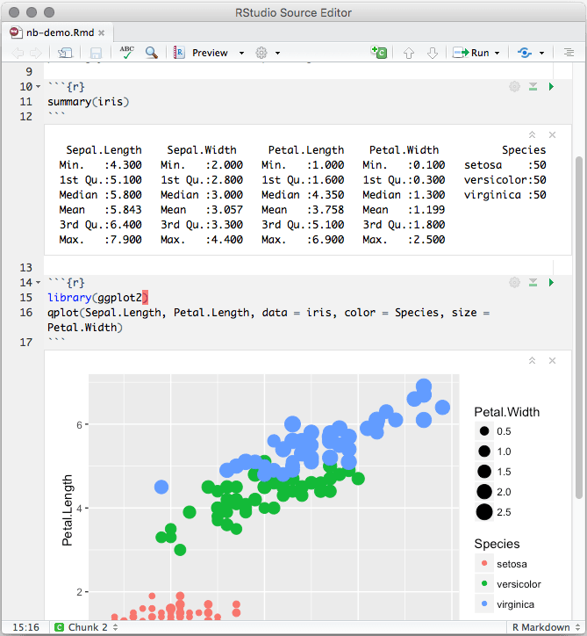
Reporting with R Markdown
Notebook Interface
When you open an .rmd in the RStudio IDE, it becomes a notebook.
You can run each code chunk by clicking the ▶ icon.
RStudio executes the code and display the results inline with your file.

Slide 10
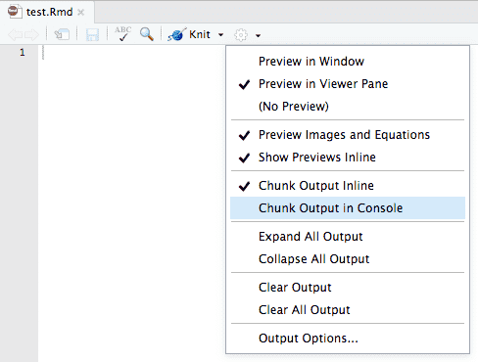
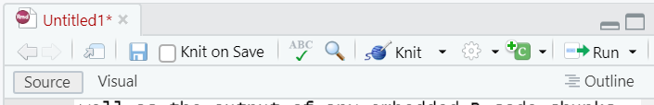
Reporting with R Markdown
Notebook Interface
By default, RStudio enables inline output (Notebook mode) on all R Markdown documents, but you can change it in settings
To generate a report from the file, run the render command:
library(rmarkdown)
render("1-example.Rmd")
Or click Knit

Slide 11
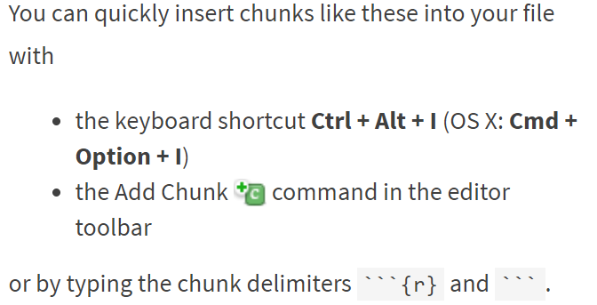
Reporting with R Markdown
Code Chunks

Slide 12
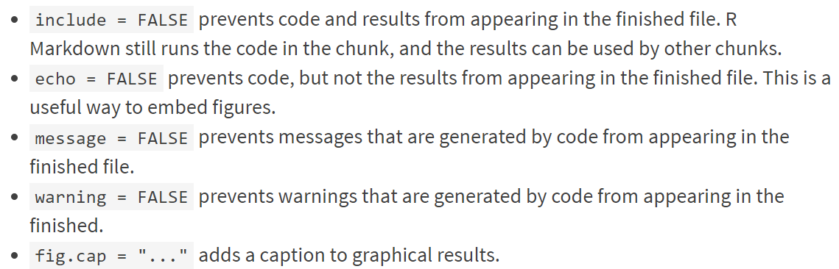
Reporting with R Markdown
Chunks Options
See the R Markdown Reference Guide for a complete list of knitr chunk options.

Slide 13
Reporting with R Markdown
Inline Code
Code results can be inserted directly into the text of a .Rmd file by enclosing the code with `r `.
```{r}
x = 5 # radius of a circle
```
For a circle with the radius `r x`, its area is `r pi * x^2`.
Chunk
Inline

Slide 14
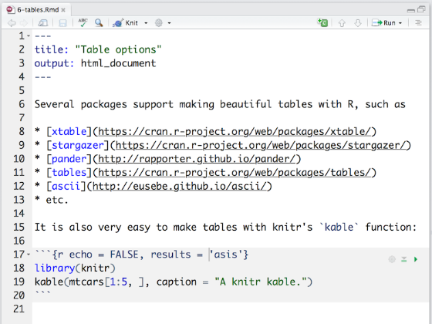
Reporting with R Markdown
Tables
By default, R Markdown displays data frames and matrixes as they would be in the R terminal (in a monospaced font).
You can use the knitr::kable function for better formatting
Note : results='asis' chunk option is required to ensure that the raw table output isn’t processed further by knitr.

Slide 15
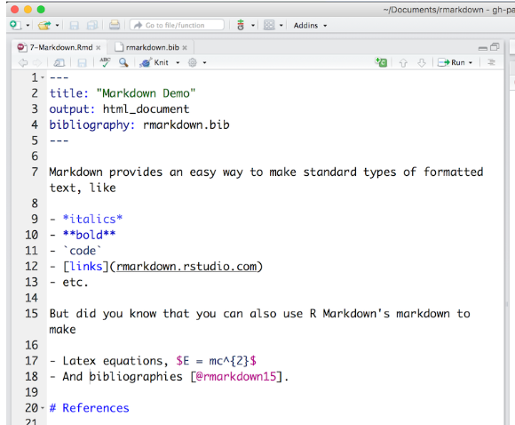
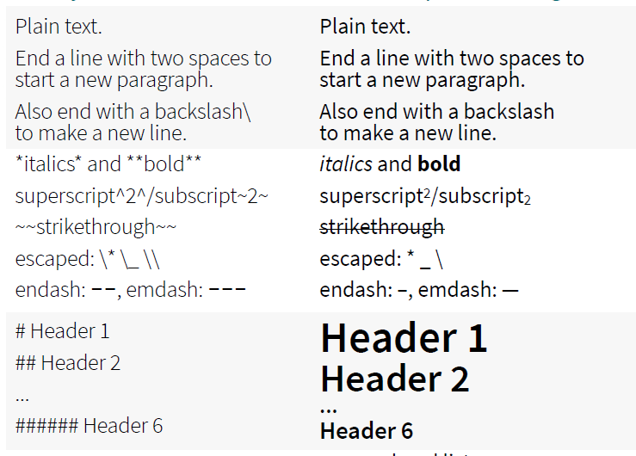
Reporting with R Markdown
Format the text in your R Markdown file with Pandoc’s Markdown
And more in R Markdown Cheatsheet

Slide 16
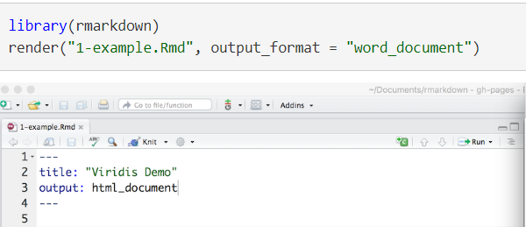
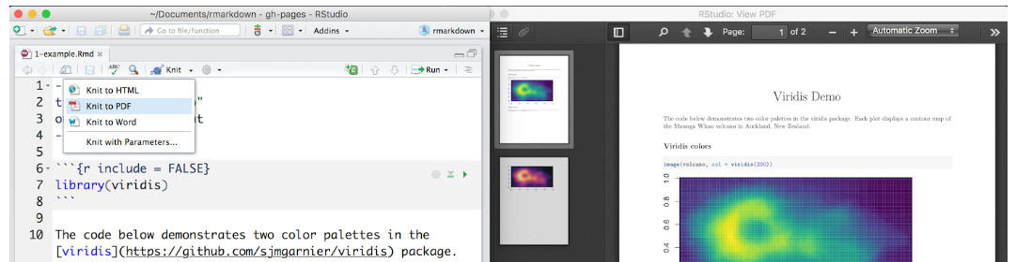
Reporting with R Markdown
Output Formats
You can define the format with code, by setting it in the YAML header, or by choosing it with the arrow near to the knit button

Slide 17

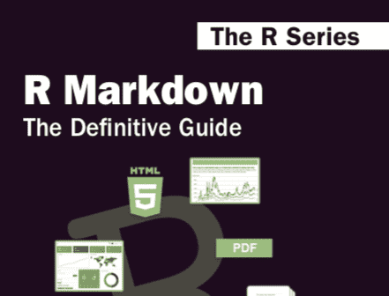
Reporting with R Markdown
For more options and further information:
https://rmarkdown.rstudio.com/lesson-1.html
https://bookdown.org/yihui/rmarkdown/

